Slide 1


TON DUC THANG UNIVERSITY
FACULTY OF ELECTRICAL AND ELECTRONICS ENGINEERING
402084 DIGITAL IMAGE PROCESSING
CHAPTER 6: ADVANCE DIGITAL IMGE PROCESSING
Vu Anh. Le, Phd.

Slide 2
OBJECTIVES
Known some advance digital processing methods
Know how to match the template.
Understand and can implement line circle detection
Briefly introduction of image and object recognition

Slide 3
CHAPTER 6: ADVANCE DIGITAL IMGE PROCESSING
1.1 TEMPLATE MATCHING
1.2 LINE DETECTION
1.3 GEOMATRY SHAPE FINDING
1.4 PATTERN RECOGNITION

Slide 4
TEMPLATE MATCHING
Filters for features
Previously, thinking of filtering as a way to remove or reduce noise
Now, consider how filters will allow us to abstract higher-level “features”.
Map raw pixels to an intermediate representation that will be used for subsequent processing
Goal: reduce amount of data, discard redundancy, preserve what’s useful

Slide 5
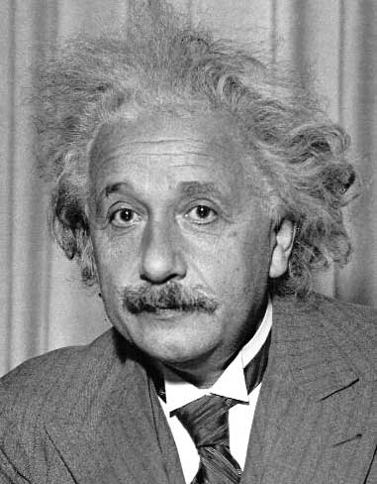
TEMPLATE MATCHING
Filters as templates:
Goal: find in image
Main challenge: What is a good similarity or distance measure between two patches?
Correlation
Zero-mean correlation
Sum Square Difference
Normalized Cross Correlation

Slide 6
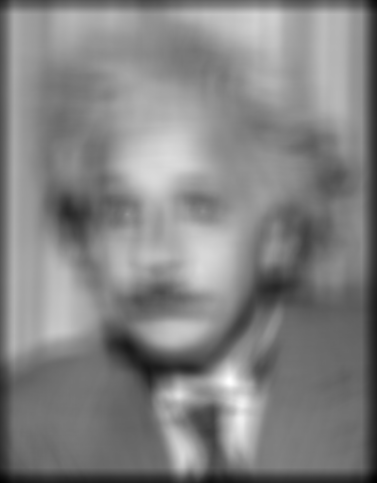
TEMPLATE MATCHING
Filters as templates:
Goal: find in image
Method 0: filter the image with eye patch
f = image
g = filter
What went wrong?
Input
Filtered Image

Slide 7
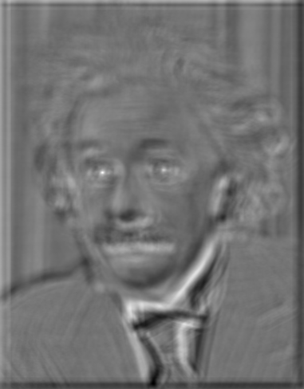

TEMPLATE MATCHING
Filters as templates:
Goal: find in image
Method 1: filter the image with zero-mean eye
mean of f
Input
Filtered Image (scaled)
Thresholded Image
True detections
False detections

Slide 8
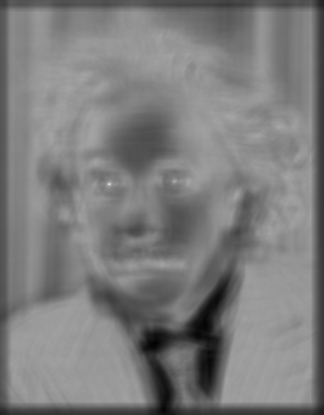

TEMPLATE MATCHING
Filters as templates:
Goal: find in image
Method 2: SSD
Input
1- sqrt(SSD)
True detections

Slide 9
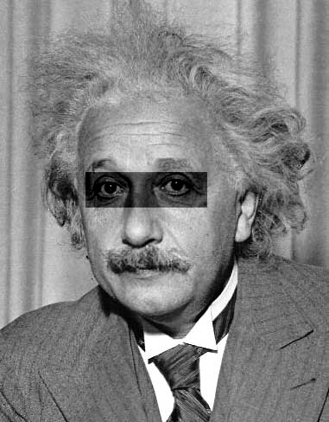
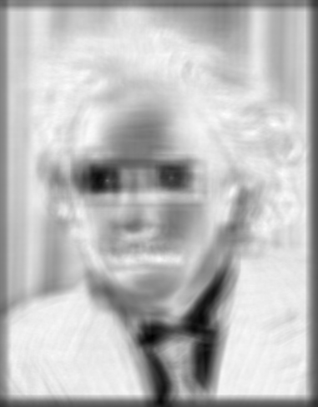
TEMPLATE MATCHING
Filters as templates:
Can SSD be implemented with linear filters?
Problem: SSD sensitive to average intensity
Input

Slide 10
TEMPLATE MATCHING
Filters as templates:
Goal: find in image
Method 3: Normalized cross-correlation
mean template
mean image patch

Slide 11
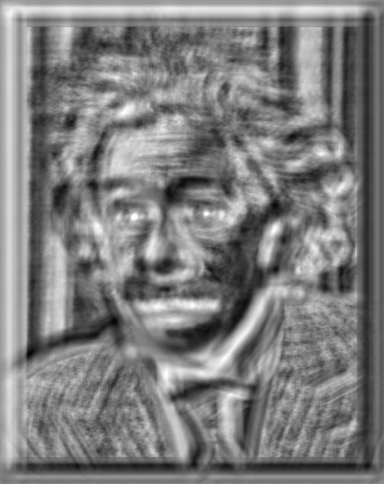

TEMPLATE MATCHING
Filters as templates:
Goal: find in image
Method 3: Normalized cross-correlation
Input
Normalized X-Correlation
Thresholded Image
True detections

Slide 12
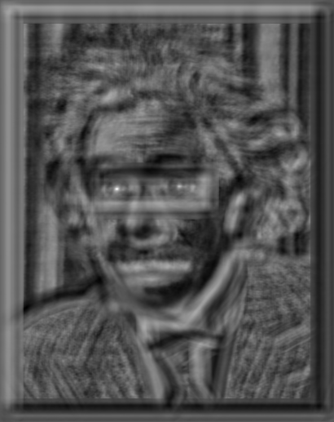
TEMPLATE MATCHING
Filters as templates:
Goal: find in image
Method 3: Normalized cross-correlation
Input
Normalized X-Correlation
Thresholded Image
True detections

Slide 13
TEMPLATE MATCHING
Filters as templates:
SSD: faster, sensitive to overall intensity
Normalized cross-correlation: slower, invariant to local average intensity and contrast

Slide 14
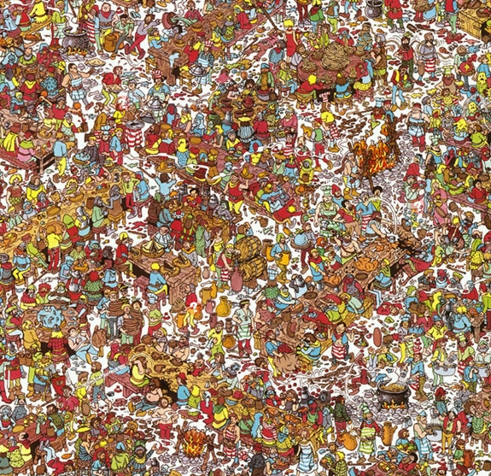
TEMPLATE MATCHING
Filters as templates:
Template
Scene

Slide 15
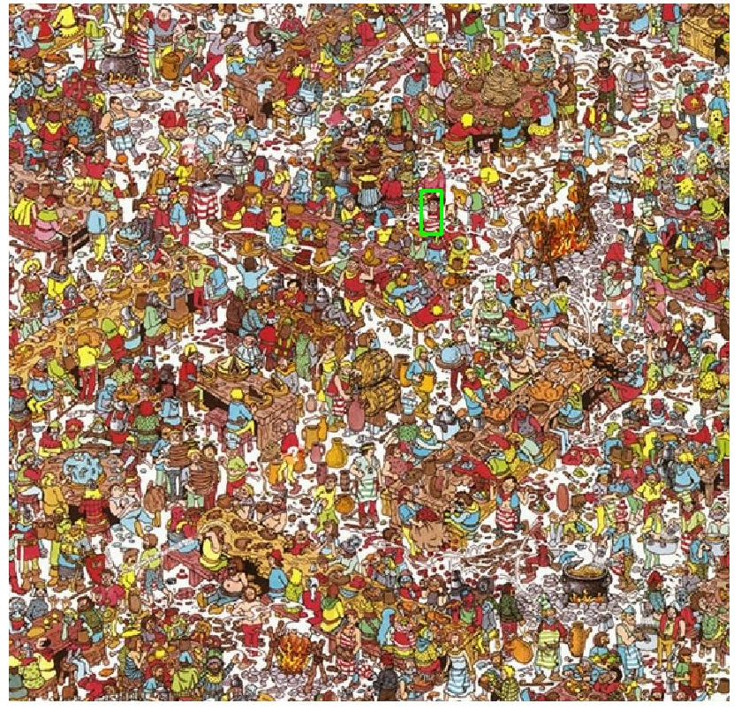
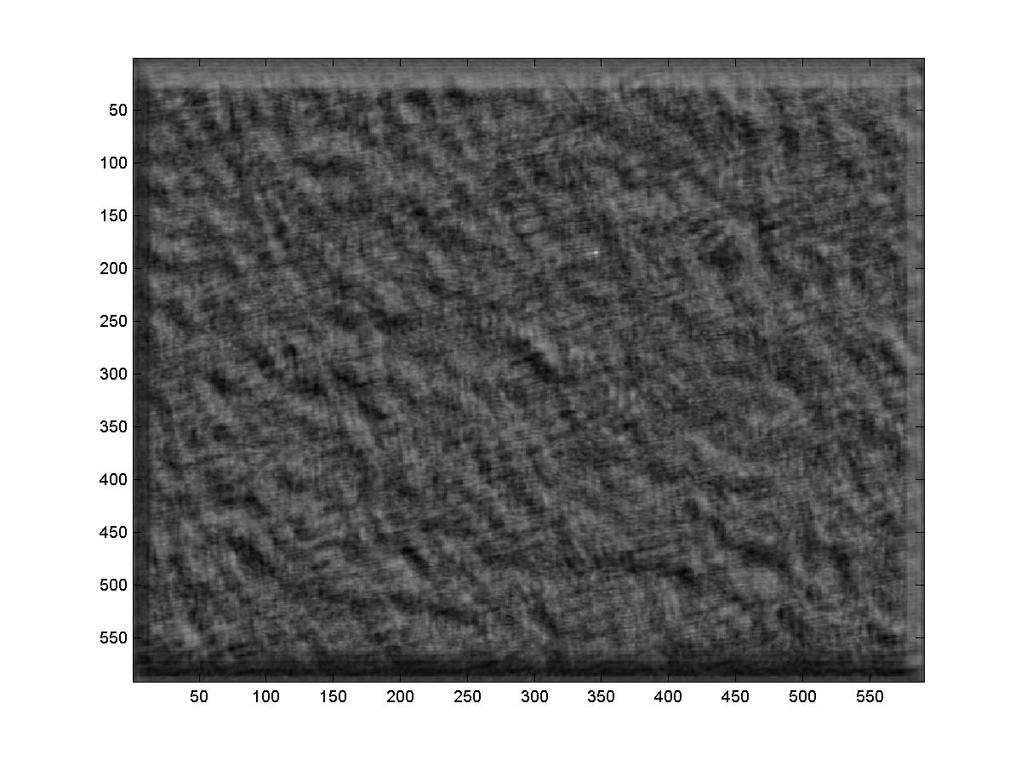
TEMPLATE MATCHING
Filters as templates:
Detected template
Correlation map

Slide 16
CHAPTER 6: ADVANCE DIGITAL IMGE PROCESSING
1.1 TEMPLATE MATCHING
1.2 LINE DETECTION
1.3 GEOMATRY SHAPE FINDING
1.4 PATTERN RECOGNITION

Slide 17
Line Detection
Hough Transform: Outline
Create a grid of parameter values
Each point votes for a set of parameters, incrementing those values in grid
Find maximum or local maxima in grid

Slide 18
Line Detection
Hough Transform: Outline
Given a set of points, find the curve or line that explains the data points best
y
m
x
b
y = m x + b
Hough space

Slide 19
Line Detection
Hough Transform: Outline
Given a set of points, find the curve or line that explains the data points best
Basic ideas :Every line in the image corresponds to a point in the parameter space

Slide 20
Line Detection
Hough Transform: Outline
y
m
b
y
x
m
3
5
3
3
2
2
3
7
11
10
4
3
2
3
1
4
5
2
2
1
0
1
3
3
b
x

Slide 21
Line Detection
Hough Transform:
Issue : parameter space [m,b] is unbounded
Use a polar representation for the parameter space
y
x
Hough space

Slide 22
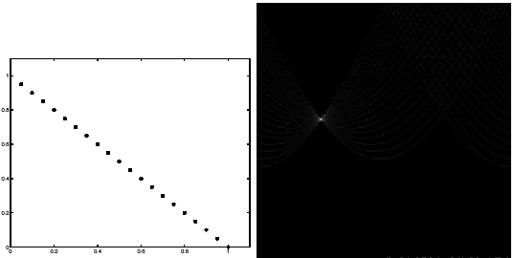
Line Detection
Hough Transform: Experiment
features
votes

Slide 23
Line Detection
Hough Transform: Experiment
Note that most points in the vote array are very dark, because they get only one vote.
features
votes

Slide 24
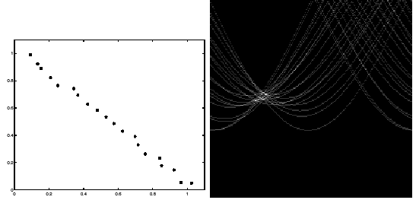
Line Detection
Hough Transform: Experiment
Noisy data
Need to adjust grid size or smooth
features
votes

Slide 25
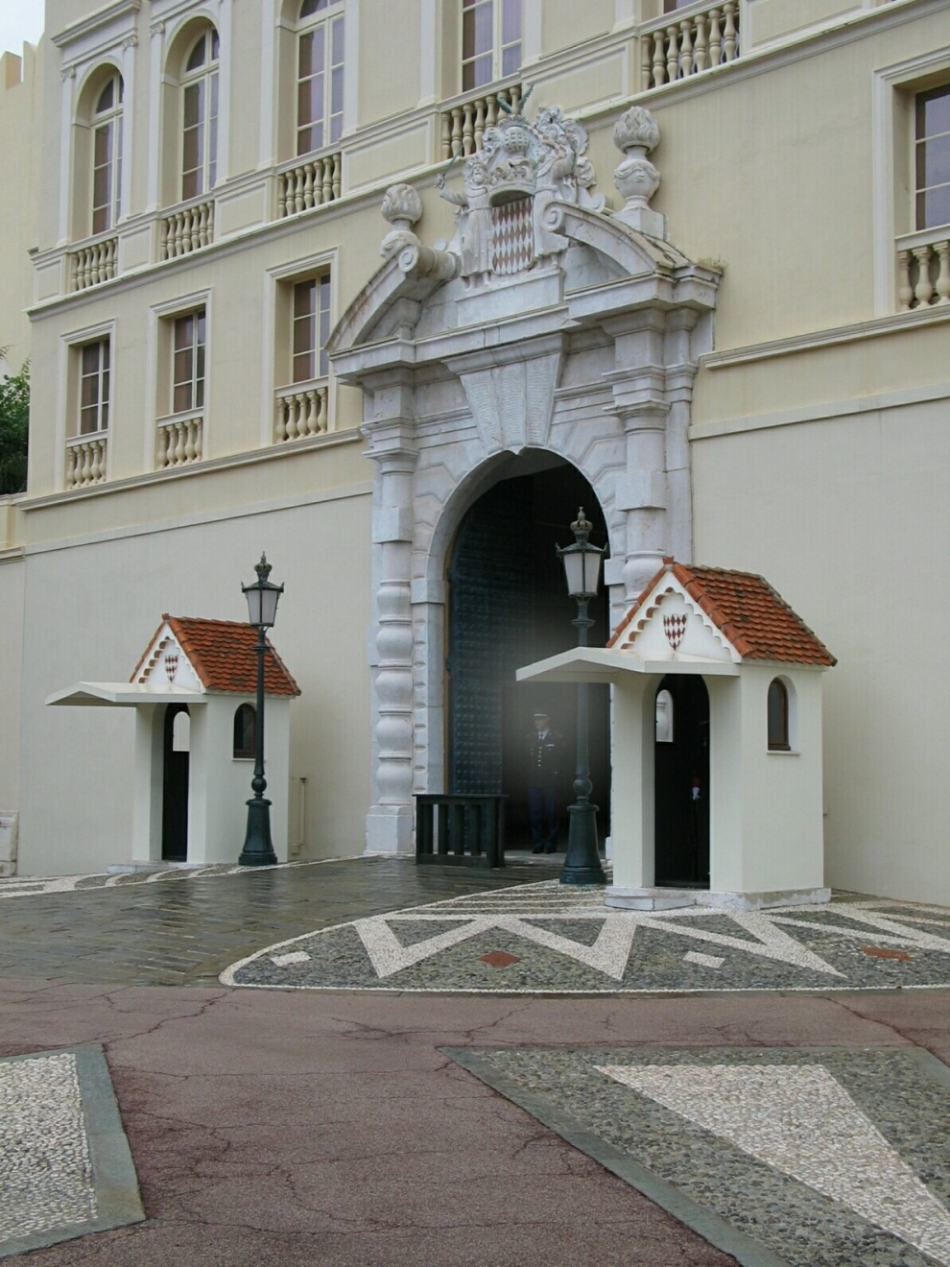
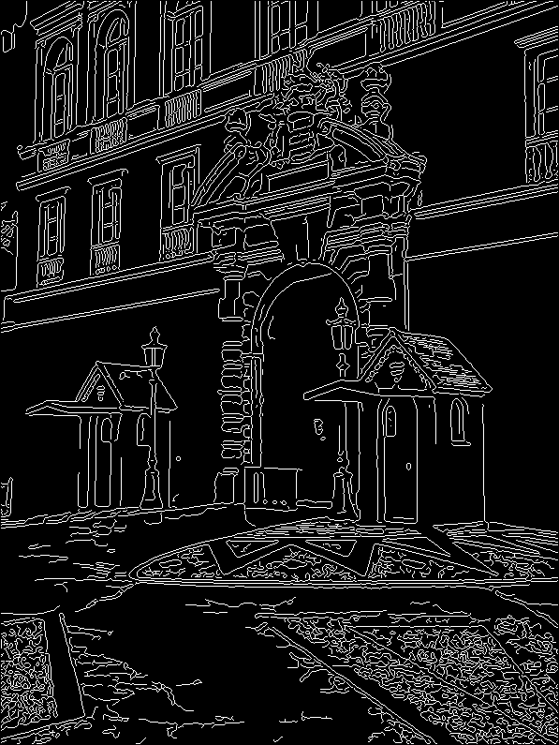
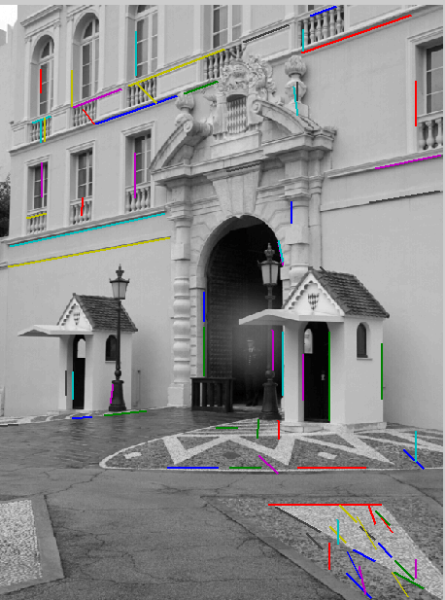
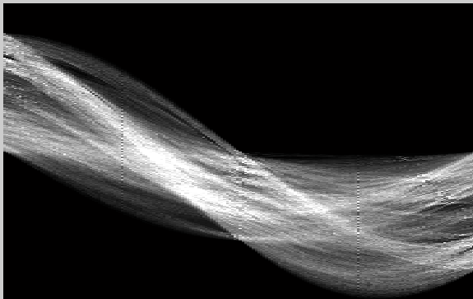
Line Detection
Hough Transform: Experiment
votes
Image
edge
results

Slide 26
Line Detection
Hough Transform: Experiment
Using m,b parameterization
Using r, theta parameterization
Using oriented gradients
Practical considerations
Bin size
Smoothing
Finding multiple lines
Finding line segments

Slide 27
CHAPTER 6: ADVANCE DIGITAL IMGE PROCESSING
1.1 TEMPLATE MATCHING
1.2 LINE DETECTION
1.3 GEOMATRY SHAPE FINDING
1.4 PATTERN RECOGNITION

Slide 28
Geometry shape Detection
Using Hough Transform
Parameterization the objects shape according the mathematic definition
Example: circle

Slide 29
Geometry shape Detection
Hough Transform for Circles
Gradient at each edge point is known
We know the line on which the center will lie
If the radius is also known then center of the circle can be located

Slide 30
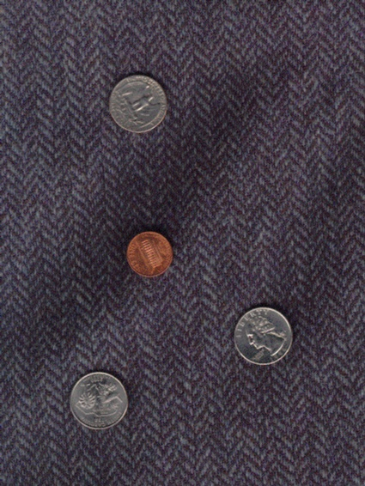
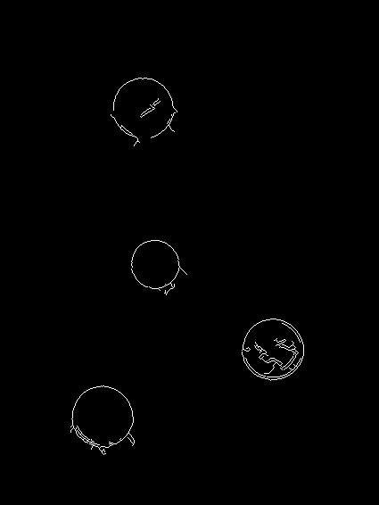
Geometry shape Detection
Hough Transform for Circles
Original Image
Circles detected by Canny Edge Detector

Slide 31
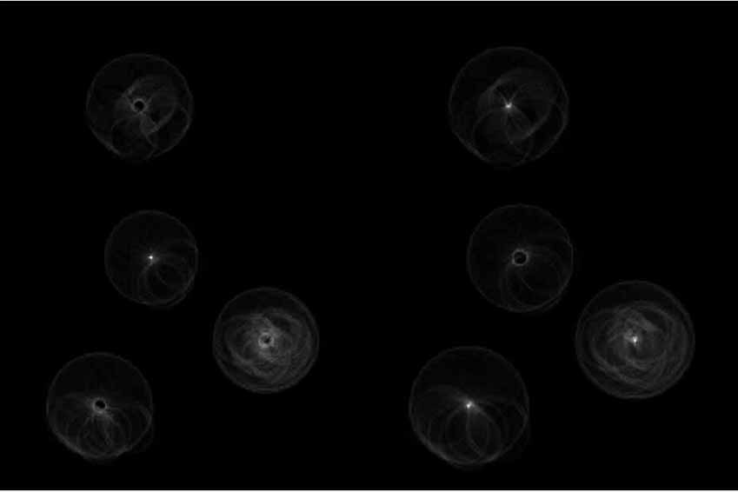
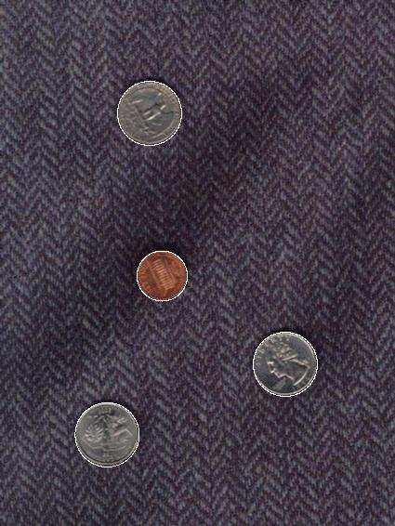
Geometry shape Detection
Hough Transform for Circles
Hough Transform of the edge detected image
Detected Circles

Slide 32
CHAPTER 6: ADVANCE DIGITAL IMGE PROCESSING
1.1 TEMPLATE MATCHING
1.2 LINE DETECTION
1.3 GEOMATRY SHAPE FINDING
1.4 PATTERN RECOGNITION

Slide 33
PATTERN RECOGNITION
Basic pattern recognition flowchart
Sensor
Feature
generation
Feature
selection
Classifier design
System evaluation

Slide 34
PATTERN RECOGNITION
Basic pattern recognition
divided into two principal areas: decision-theoretic and structural
The first category deals with patterns described using quantitative descriptors, such as length, area, and texture
The second category deals with patterns best described by qualitative descriptors, such as the relational descriptors.

Slide 35
PATTERN RECOGNITION
Basic pattern recognition: Matching Shape Numbers
The Direction numbers for 4-directional chain code, and 8-directional chain code
1
2
3
1
2
0
4
0
5
7
3
6

Slide 36
PATTERN RECOGNITION
Basic pattern recognition: Matching Shape Numbers
All shapes of order 4, 6,and 8
Order6
Order4
Chain code: 0321
Difference : 3333
Shape no. : 3333
Chain code: 003221
Difference : 303303
Shape no. : 033033
Order8
Chain code: 00332211
Difference : 30303030
Shape no. : 03030303
Chain code:03032211
Difference :33133030
Shape no. :03033133
Chain code: 00032221
Difference : 30033003
Shape no. : 00330033

Slide 37
SUMMARY
In this chapter we have learn:
some advance digital processing methods
how to match the template.
implement line and circle detection
introduction of image and object recognition

Slide 38
HOMEWORK
Review the chapter 6
Read more (pp. 883-928 )
Solve the exercise: 6.1, 6.2,, 6.5, 6.7, 6.11, 6.12, 6.15.

